Slide 1
SSZG 518: Database Design and Applications
Today’s Class
Relational Model - Querying

Slide 2
Types of Relations
Base Relations
The original (given) relations
Derived Relations
Relations obtained from base relations
Views
“Virtual” derived relation
Only definition is stored in the catalog
Definition executed at run-time
Snapshots
“Real” derived relation
Query Result
Unnamed derived relation

Slide 3
Operations on Relations
Select
Project
Join
Divide
Union
Intersection
Difference
Product
Relational Operations
Set Operations

Slide 4
Select & Project

Slide 5
Union, Intersection & Difference

Slide 6
Union, Intersection & Difference
Union Compatibility: r U s is valid if:
Relations r & s have the same arity
Domains of the i^{th} attribute of r is the same as the domain of the i^{th} attribute of s, ⍱ i.
Note that r & s can be either database relations or derived relations

Slide 7
Relational Model
Sets
collections of items of the same type
no order
no duplicates
Mappings
domain
range
1:many
many:1
1:1
many:many

Slide 8

Exercise
What are the mapping cardinalities of the following 4 relationships?
A
B
C
D

Slide 9
Relational Query Languages
Procedural vs.non-procedural, or declarative
“Pure” languages:
Relational algebra
Tuple relational calculus
Domain relational calculus
Relational operators

Slide 10
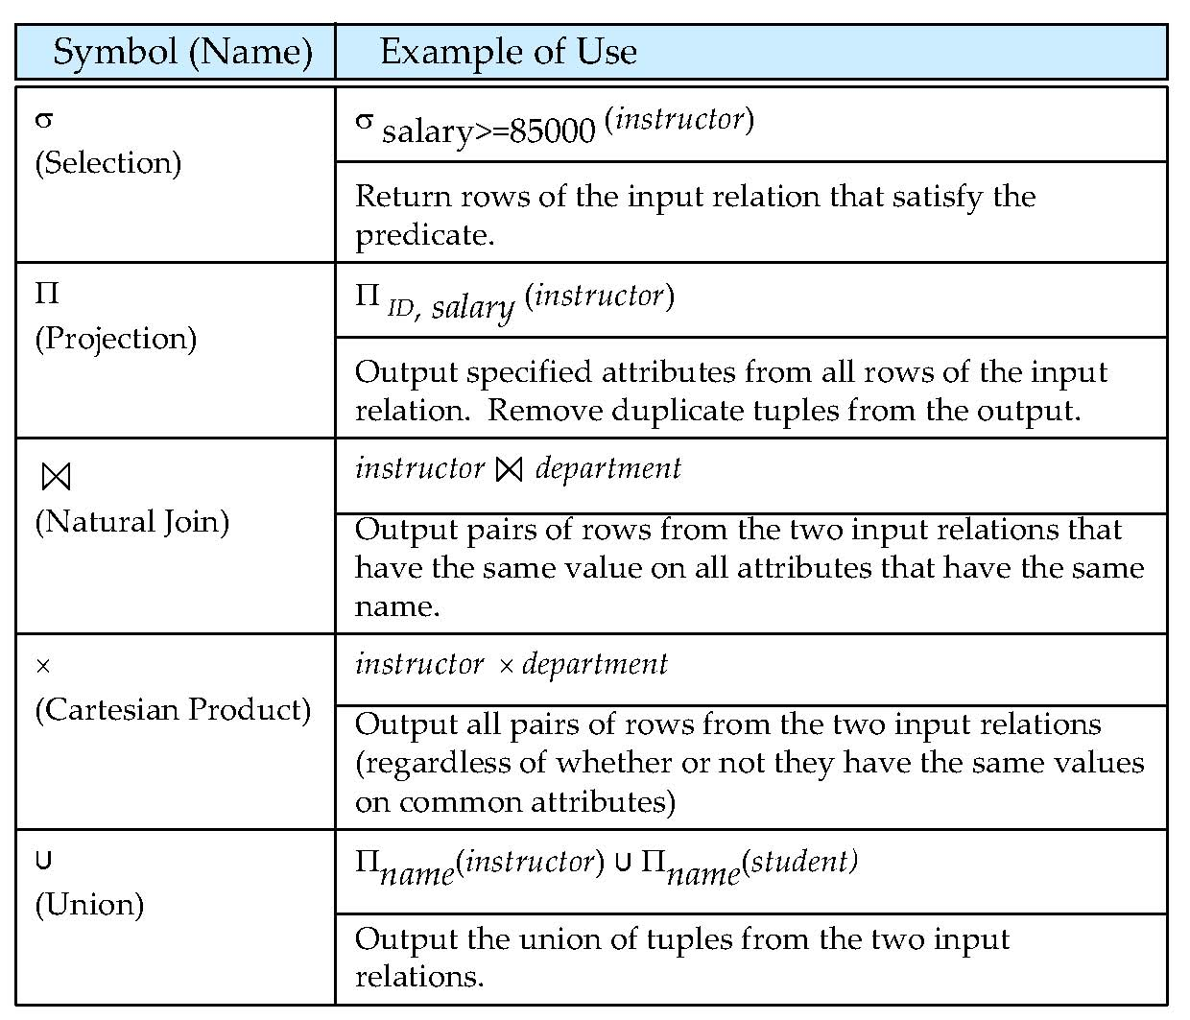
Relational Algebra Operators

Slide 11
Select Operation – Example
Relation r
A
B
C
D
α
α
β
β
α
β
β
β
1
5
12
23
7
7
3
10
Select tuples with A=B and D > 5
σ_{A=B ^ D > 5} (r)
A
B
C
D
α
β
α
β
1
23
7
10

Slide 12
Project Operation – Example
Relation r:
Selection of Columns (Attributes)
A
B
C
α
α
β
β
10
20
30
40
1
1
1
2
Select A and C
A
C
A
C
∏_{A,C} (r)
α
α
β
β
1
1
1
2
α
β
β
1
1
2
=

Slide 13
Joining two relations – Cartesian Product
Relations r, s:
A
B
C
D
E
α
β
1
2
α
β
β
γ
10
10
20
10
a
a
b
b
r
s
r x s:
A
B
C
D
E
α
α
α
α
β
β
β
β
1
1
1
1
2
2
2
2
α
β
β
γ
α
β
β
γ
10
10
20
10
10
10
20
10
a
a
b
b
a
a
b
b

Slide 14
Union of two relations
Relations r, s:
α
α
β
1
2
1
α
β
2
3
s
r
r ∪ s:
A
B
α
α
β
β
1
2
1
3

Slide 15
Set difference of two relations
Relations r, s:
α
α
β
1
2
1
α
β
2
3
s
r
r – s:
A
B
α
β
1
1

Slide 16
Set Intersection of two relations
Relation r, s:
r ∩ s
A B
A B
α
α
β
1
2
1
α
β
2
3
r
s
A B
α 2

Slide 17
Natural Join Example
Relations r, s:
A
B
C
D
α
β
γ
α
δ
1
2
4
1
2
α
γ
β
γ
β
a
a
b
a
b
1
3
1
2
3
a
a
a
b
b
α
β
γ
δ
∈
Natural Join
r s
r
s
A
B
C
D
E
α
α
α
α
δ
1
1
1
1
2
α
α
γ
γ
β
a
a
a
a
b
α
γ
α
γ
δ

Slide 18
Joining two relations – Natural Join
Let r and s be relations on schemas R and S respectively. Then, the “natural join” of relations R and S is a relation on schema R ∪ S obtained as follows:
Consider each pair of tuples t_{r} from r and t_{s} from s.
If t_{r} and t_{s} have the same value on each of the attributes in R ∩ S, add a tuple t to the result, where
t has the same value as t_{r} on r
t has the same value as t_{s} on s

Slide 19
Natural Join
Example:
R = (A, B, C, D)
S = (E, B, D)
Result schema = (A, B, C, D, E)
r s is defined as: ∏_{r.A, r.B, r.C, r.D, s.E} (σ_{r.B = s.B} ∧ _{r.D = s.D} (r x s))

Slide 20
Preliminaries
A query is applied to relation instances, and the result of a query is also a relation instance.
Schemas of input relations for a query are fixed.
The schema for the result of a given query is also fixed! - determined by definition of query language constructs.
Positional vs. named-field notation:
Positional notation easier for formal definitions, named-field notation more readable.
Both used in SQL
Notes:
4

Slide 21
Relational Algebra
Basic operations:
Selection ( ) Selects a subset of rows from relation.
Projection ( ) Deletes unwanted columns from relation.
Cross-product ( ) Allows us to combine two relations.
Set-difference ( ) Tuples in reln. 1, but not in reln. 2.
Union ( ) Tuples in reln. 1 and in reln. 2.
renaming ( ρ ): Not essential, but (very!) useful.
Additional operations:
Intersection, join, division,
The operators take one or two relations as inputs and produce a new relation as a result.
Since each operation returns a relation, operations can be composed: algebra is “closed”.
Notes:
6

Slide 22
Formal Definition
A basic expression in the relational algebra consists of either one of the following:
A relation in the database
A constant relation
Let E₁ and E₂ be relational-algebra expressions; the following are all relational-algebra expressions:
E₁ ∪ E₂
E₁ – E₂
E₁ x E₂
σ_{p} (E₁), P is a predicate on attributes in E₁
∏_{s}(E₁), S is a list consisting of some of the attributes in E₁
ρ _{x} (E₁), x is the new name for the result of E₁

Slide 23
Composition of Operations
Can build expressions using multiple operations
Example: σ_{A=C}(r x s)
r x s
σ_{A=C}(r x s)
A
B
C
D
E
Results of relational operations are relations themselves.
Compositions of operations form a relational-algebra expression.
α
α
α
α
β
β
β
β
1
1
1
1
2
2
2
2
α
β
β
γ α
β
β
γ
10
10
20
10
10
10
20
10
a
a
b
b
a
a
b
b
A
B
C
D
E
α
β
β
α
β
β
10
10
20
1
2
2
a
a
b

Slide 24
Figure 2.1 Relational database for Practice Exercise 2.1.
employee (person name, street, city)
works (person name, company name, salary)
company (company name, city)

Slide 25
Banking Example
branch (branch_name, branch_city, assets)
customer (customer_name, customer_street, customer_city)
account (account_number, branch_name, balance)
loan (loan_number, branch_name, amount)
depositor (customer_name, account_number)
borrower (customer_name, loan_number)

Slide 26
Select Operation
Select operation returns a relation that satisfies the given predicate from the original relation.
Notation: σ _{p}(r)
p is called the selection predicate
Defined as: σ_{p}(r) = {t | t ∈ r and p(t)}
Where p is a formula in propositional calculus consisting of terms connected by : ∧ (and), ∨ (or), ¬ (not) Each term is one of:
<attribute> op <attribute> or <constant>
where op is one of: =, ≠, >, ≥. <. ≤
Example of selection: σ _{branch_name=“Perryridge”}(account)

Slide 27
Project Operation
Returns a relation with only the specified attributes.
Notation:
where A₁, A₂ are attribute names and r is a relation name.
The result is defined as the relation of k columns obtained by erasing the columns that are not listed
Duplicate rows removed from result, since relations are sets
Example: To eliminate the branch_name attribute of account ∏_{account_number, balance} (account)

Slide 28
Union Operation
Results in a relation with all of the tuples that appear in either or both of the argument relations.
Notation: r ∪ s
Defined as:
r ∪ s = {t | t ∈ r or t ∈ s}
For r ∪ s to be valid.
1. r, s must have the same arity (same number of attributes)
2. The attribute domains must be compatible (example: 2nd column of r deals with the same type of values as does the 2nd column of s)
Example: to find all customers with either an account or a loan ∏_{customer_name} (depositor) ∪ ∏_{customer_name} (borrower)

Slide 29
Set Difference Operation
R – S produces all tuples in R but not in S
Notation r – s
Defined as:
r – s = {t | t ∈ r and t ∉ s}
Set differences must be taken between compatible relations.
r and s must have the same arity
attribute domains of r and s must be compatible

Slide 30
Cartesian-Product Operation
Combines any two relations
Output has the attributes of both relations
Notation r x s
Defined as:
r x s = {t q | t ∈ r and q ∈ s}
Assume that attributes of r(R) and s(S) are disjoint. (That is, R ∩ S = ∅).
If attributes of r and s are not disjoint, then renaming must be used.
Repeated attribute names are preceded by the relation they originated from.
Example: r= borrower × loan
(borrower.customer-name, borrower.loan-number,
loan.loan-number, loan.branch-name, loan.amount)

Slide 31
Rename Operation
Allows us to name, and therefore to refer to, the results of relational-algebra expressions.
Allows us to refer to a relation by more than one name.
Example:
ρ _{x} (E)
returns the expression E under the name X
If a relational-algebra expression E has arity n, then
returns the result of expression E under the name X, and with the
attributes renamed to A₁ , A₂ , …., A_{n} .
Useful for naming the unnamed relations returned from other operations.

Slide 32
Set-Intersection Operation
Results in a relation that contains only the tuples that appear in both relations.
Notation: r ∩ s
Defined as:
r ∩ s = { t | t ∈ r and t ∈ s }
Assume:
r, s have the same arity
attributes of r and s are compatible
Note: r ∩ s = r – (r – s)

Slide 33
Example Instances
R1
“Sailors” and “Reserves” relations for our examples.
S1
S2
Notes:
5

Slide 34
Projection
Deletes attributes that are not in projection list.
Schema of result contains exactly the fields in the projection list, with the same names that they had in the input relation.
Projection operator has to eliminate duplicates! Why?
Note: real systems typically don’t do duplicate elimination unless the user explicitly asks for it (by DISTINCT). Why not?
Notes:
7

Slide 35
Selection
Selects rows that satisfy selection condition.
No duplicates in result! Why?
Schema of result identical to schema of input relation.
What is Operator composition?
Selection is distributive over binary operators
Selection is commutative
Notes:
8

Slide 36
Union, Intersection, Set-Difference
All of these operations take two input relations, which must be union-compatible:
Same number of fields.
`Corresponding’ fields have the same type.
What is the schema of result?
Notes:
9

Slide 37
Theta Join
Condition Join:
Result schema same as that of cross-product.
Fewer tuples than cross-product, might be able to compute more efficiently
Sometimes called a theta-join.
Notes:
11

